Slide 1
Lego Group
An outsourcing journey
Ben, Elvar, Enrico & Valeria
Notes:
ben

Slide 2
Table of contents
01
02
03
04
Case
background
Challenges
& pROBLEM
STATEMENT
aLTERNATIVES
Recommendation
& Action plan
Notes:
ben

Slide 3
01
case
background
Notes:
ben

Slide 4
History of lego group
The Lego Group was founded in 1932 by Ole Kirk Kristiansen
Mission Statement: to inspire and develop the builders of tomorrow.
Partnership with Flextronics
Product offerings
Brand values: imagination, creativity, fun, learning, caring, and quality
1998-2004: economic losses equal to $310,000 per day
  Tried diversifying product line which led to “vast complexity and inefficiencies”
Notes:
Ben
Mission: The word Lego stems from two Danish words “leg godt," meaning "play well.”
Partnership: Only lasted 3 years with Flextronics because the result of attempting to manage and overcome the complexity of the production network by outsourcing it to external providers was actually only a more complex global manufacturing footprint. Lego also needed a more flexible business model to meet fluctuations in demand, which Flextronics could not accommodate to.
Product offerings: Lego toys, computer games, TV, and clothing
Historically, Lego has struggled to stay profitable within its business plan, partly due to its partnership with Flextronics, which only lasted three years. In fact, from 1998 to 2024, Lego lost around $310,000 per day. By outsourcing production, Lego created a “more complex global manufacturing footprint,” which hurt their bottom line when seasonal demand changed (Larson, page 7).

Slide 5
History of lego group Continued
Strategy changed:
  “Be the best at creating value for our customers and sales channels.”
  “Refocus on the value we offer our customers.”
  “Increase operational excellence.”
Business Development: focused on documenting business practices
  Standardizing it’s processes
Notes:
Ben
Standardization: With the production of around 24 billion bricks per year, a high degree of standardization was obviously imperative for the extreme accuracy required
Chresten Bruun, a senior production director said “We are standardizing on three levels,” he said, “the upper level: that is our way of thinking, our mindset, values, attitudes; on the mid level: how we operate our planning processes, follow-up processes, etc.; and the lower level: that is more the hardware part, the machines, lines and the layout in the production.”

Slide 6
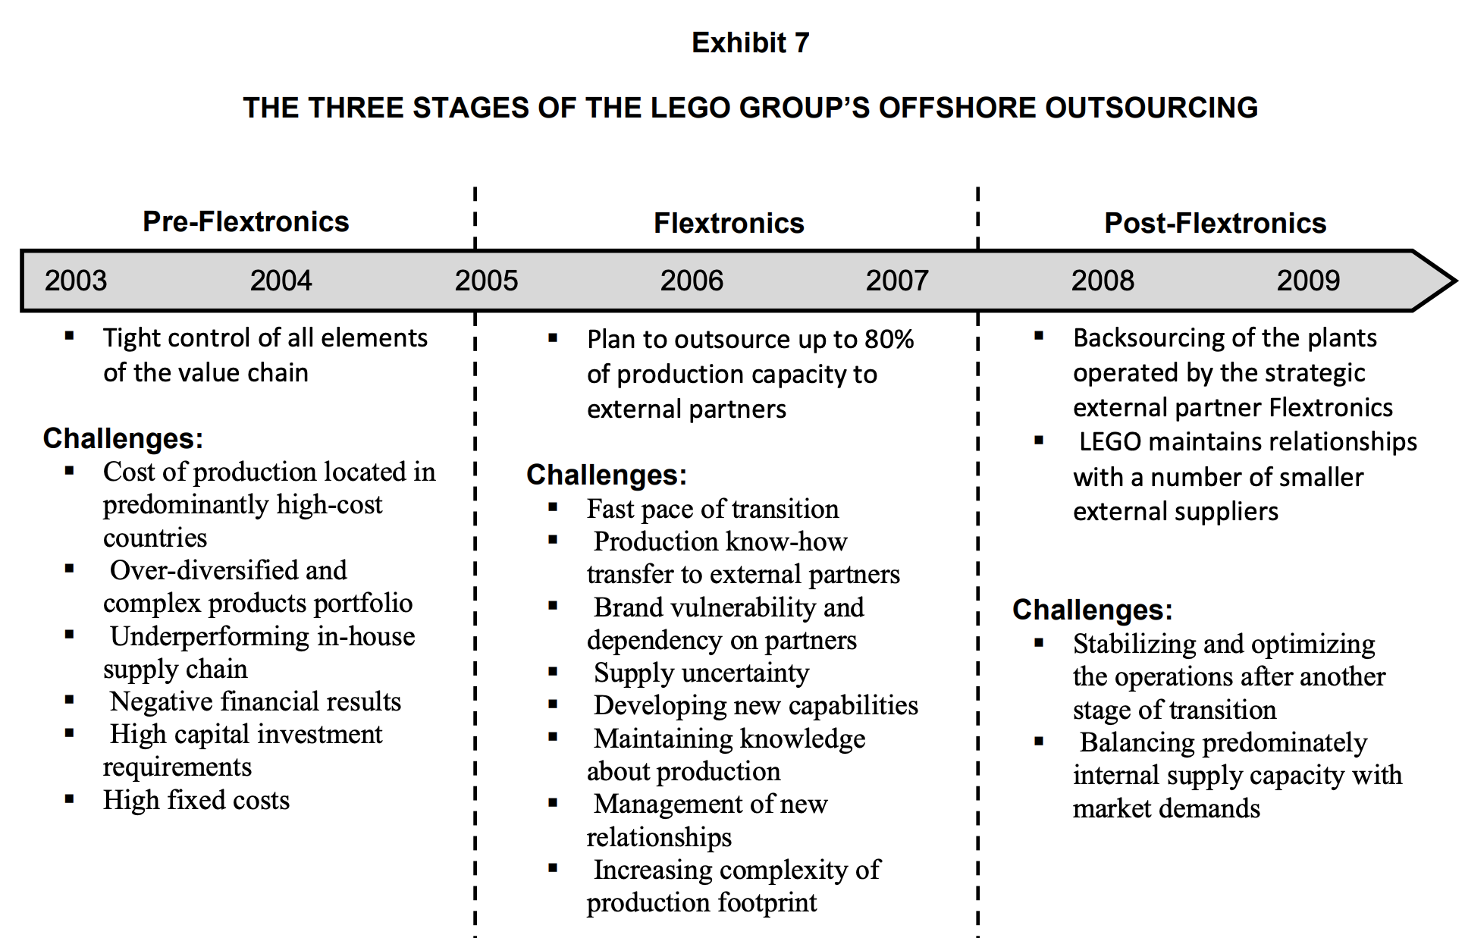

Slide 7
02
Challenges
& problem statement
Notes:
valeria

Slide 8
Challenges faced
01
Sales Decline
02
Product diversification
03
Production price increase
Notes:
valeria
Lego Group decided to diversify its product offerings to counterbalance a decline in sales of the Lego brick product. However, it failed to predict the increase in the price of materials and the complexity of the production for each of its new toy lines.
On top of that, Lego had 130 different colors for each of their traditional Lego bricks. Some new product offerings had exclusive partnerships, meaning the pieces were not interchangeable with other sets.
Due to its highly seasonal sales, Lego Group’s sales forecasting was inaccurate. Because many of the Lego bricks were shared among various product offerings, it was common for out-of-stock inventory issues to happen.
When a particular set would sell more than forecasted, it consumed some supply of parts for other Lego sets. To prevent shortages, Lego had to carry a huge amount of excess inventory, which, combined with its dispersed distribution centers, would drive its supply chain costs high. The rise in supply chain costs and overall inefficiency made Lego less competitive in the market, forcing Lego Group to implement changes to its business model or its supply chain structure.

Slide 9
Challenges continued…
market conditions
Flextronics
partnership
Financial management
Lego Group's management didn't adapt quickly to changing market conditions.
Flextronics seemed to prioritize its own interest in gaining insights into the plastics industry
Poor management of finances led to great losses
Notes:
Valeria
The Lego Group faced several critical issues that required prompt action to prevent further financial losses and potential bankruptcy. In the 1990s, the company focused on
independent retailers while competitors shifted their attention to large retail chains. Unfortunately, Lego Group's management didn't adapt quickly to changing market conditions. Instead of investigating why their profits were decreasing, the company invested in diversification. This diversification, which included ventures into apparel, theme parks, TV, and film, created a complicated product lineup unrelated to their core expertise in children's toys. This consumed management resources that should have been dedicated to improving the cost efficiency of their existing products.
The Lego Group entered into an outsourcing agreement with Flextronics, hoping that a partnership could resolve their ongoing supply chain issues. However, both parties missed a crucial step in assessing the business requirements thoroughly before finalizing the contract. If they had, they would have realized that Flextronics wasn't the right fit for a company since Flextronics could not deal with Lego’s fluctuating seasonal demand and frequent engineering changes. Flextronics seemed to prioritize its own interest in gaining insights into the plastics industry. They profited from the deal and improved their knowledge of plastics. On the other hand, it appeared that Lego Group's management didn't have a deep understanding of their own business and were looking for external help.
A significant problem was that Lego Group didn't keep a close eye on the costs of engineering, manufacturing, and production compared to their income. They wouldn't have suffered such significant losses if they had managed their finances better. The company's motto, “Only the best is good enough,” discouraged cost-saving measures as these were seen as a threat to product quality. Unfortunately, this approach resulted in many dedicated employees who embodied this motto losing their jobs due to management oversight.

Slide 10
problem statement
The Lego Group has undergone significant changes within its supply chain to create a lean operation while upholding the same quality standards. The global diversification in their supply chain has hindered Lego’s growth, and they need to standardize their processes to become flexible in accordance with demand.
Notes:
valeria
The Lego Group has undergone significant changes within its supply chain to create a lean operation while upholding the same quality standards. The global diversification in their supply chain has hindered Lego’s growth, and they need to standardize their processes to become flexible in accordance with demand.
Transition to alternatives enrico

Slide 11
03
Alternatives
Notes:
Enrico

Slide 12
01
02
03
Re-attempt
collaboration
Level out
quarterly demand
Subscription
based toy set
Notes:
Enrico
The first opportunity that Lego can capitalize on is working with an outsourced company that actually aligns with their business practices. Unlike Flextronics, if they can find a production company that can quickly adapt to changes in seasonal demand, they can better provide value to customers and reduce production times. It would be essential for Lego to work alongside a flexible manufacturing facility that can standardize its business practices. Standardization will create a clear structure for sustained growth from upper to lower levels of business practices. By outsourcing the actual production of the Legos bricks while still maintaining their main core competency of the Lego build designs, they can lower their costs and still create value for the end customer.
Another opportunity that Lego Group could implement in order to mitigate supply chain inefficiencies and costs would be to smooth out its yearly demand across all quarters. As highlighted previously, one of the main problems that Lego Group faced with its supply chain was the inability to accurately forecast sales throughout the year due to the high-seasonality of the market. Even after integrating Flextronics for its production forecasting, the Lego Group still suffered from shortages and high costs of inventory. By implementing a highly-efficient marketing campaign alongside a seasonal sale for the months of low demand, Lego could smooth out the demand throughout the year and decrease the amount of safety inventory needed. Ultimately lowering the overall supply chain inefficiencies and costs. Additionally, Lego could push for marketing surrounding the child's birthday, which is uniformly distributed across the year.
The last recommendation for Lego is to implement a subscription-based toy set for developmental ages that would be delivered every month. This recommendation aims to help Lego lower their margin of error in forecasting demand but smoothing out the demand curve over time. This method of sales growth would help reduce seasonal demand because they would have consistent monthly sales over the fiscal year.

Slide 13
PROS & CONS
Alternative | PROS | CONS
1 | Multiply the value provided to customers if successful | Partnership could fail again, resulting in more losses
2 | Marketing campaign could bring in additional sales | Could accumulate more inventory if not sold by quarter end
3 | Lower the margin of error forecasting demand | May require additional marketing expenses
Notes:
enrico

Slide 14
04
Recommendation
Notes:
elvar

Slide 15
aCTION PLAN
first
Second
third
Find compatible partner
Tackle supply chain inefficiencies
Introduce subscription based model into the market
Notes:
elvar
To secure the long-term success of the Lego Group, and to remain profitable while maintaining their core competencies and competitive advantages, the company should implement the three alternatives suggested. First, they should find a manufacturing partner that aligns with their practices, can adapt to varying demand, and standardizes their processes, which will help reduce costs while maintaining quality. Second, to tackle supply chain inefficiencies and costs, they can level out their demand throughout the year through seasonal sales and marketing campaigns, targeting children's birthdays. Lastly, they can introduce a subscription-based model for toy sets tailored to different age groups, ensuring consistent monthly sales.
These steps will collectively streamline production, cut supply chain inefficiencies, and ensure a stable revenue stream, bolstering the company's long-term sustainability.

Slide 16
Thank
you!
Please keep this slide for attribution
Notes:
elvar

Slide 17
Works cited
Lego Group: An Outsourcing Journey, Larsen, Marcus Møller, Pedersen, Torben, Slepinov, Dmitrij, May 2010, Ivey Publishing / Harvard Business Publishing

